Slide 1
Overview of Current LLNL
Science and Engineering Hiring Opportunities
NNSA Minority Serving Institutions
Presented by
Tommy E. Smith
November 9, 2010
This work performed under the auspices of the U.S. Department of Energy by Lawrence Livermore National Laboratory under Contract DE-AC52-07NA27344

Slide 2
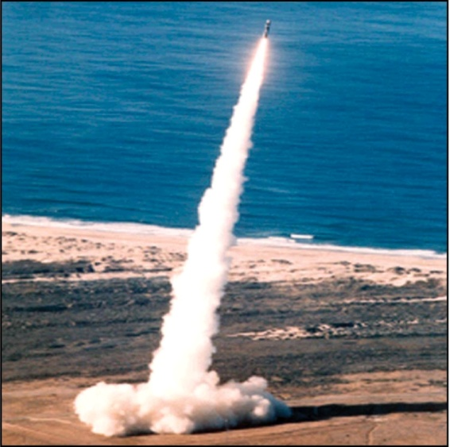
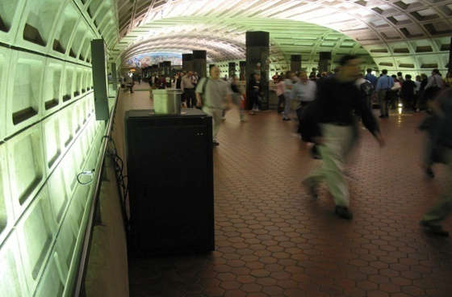
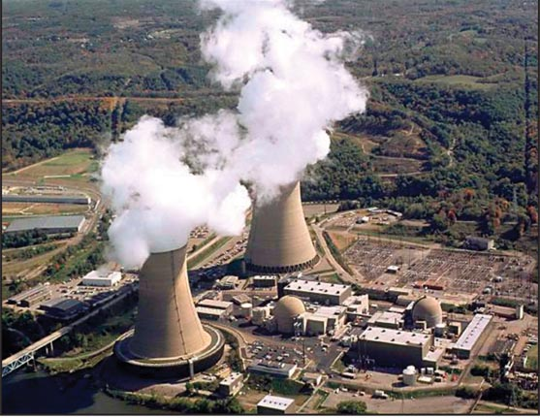
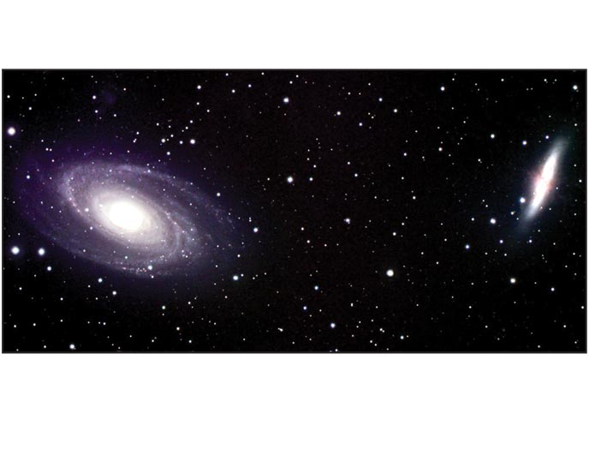
LLNL Vision: National Security in a Global Context
Stockpile Stewardship
Global Security
Energy & Environment
Basic Science
Pursuing global security through the application of multidisciplinary S&T to enhance national security, meet energy and environment needs and enhance economic competitiveness

Slide 3
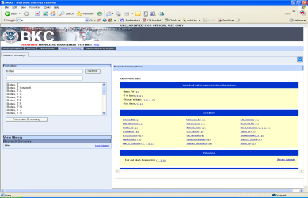
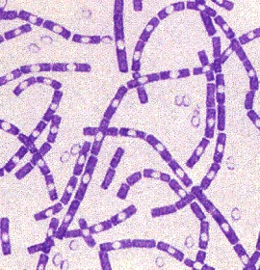
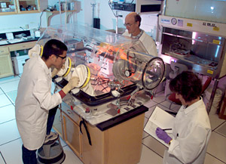
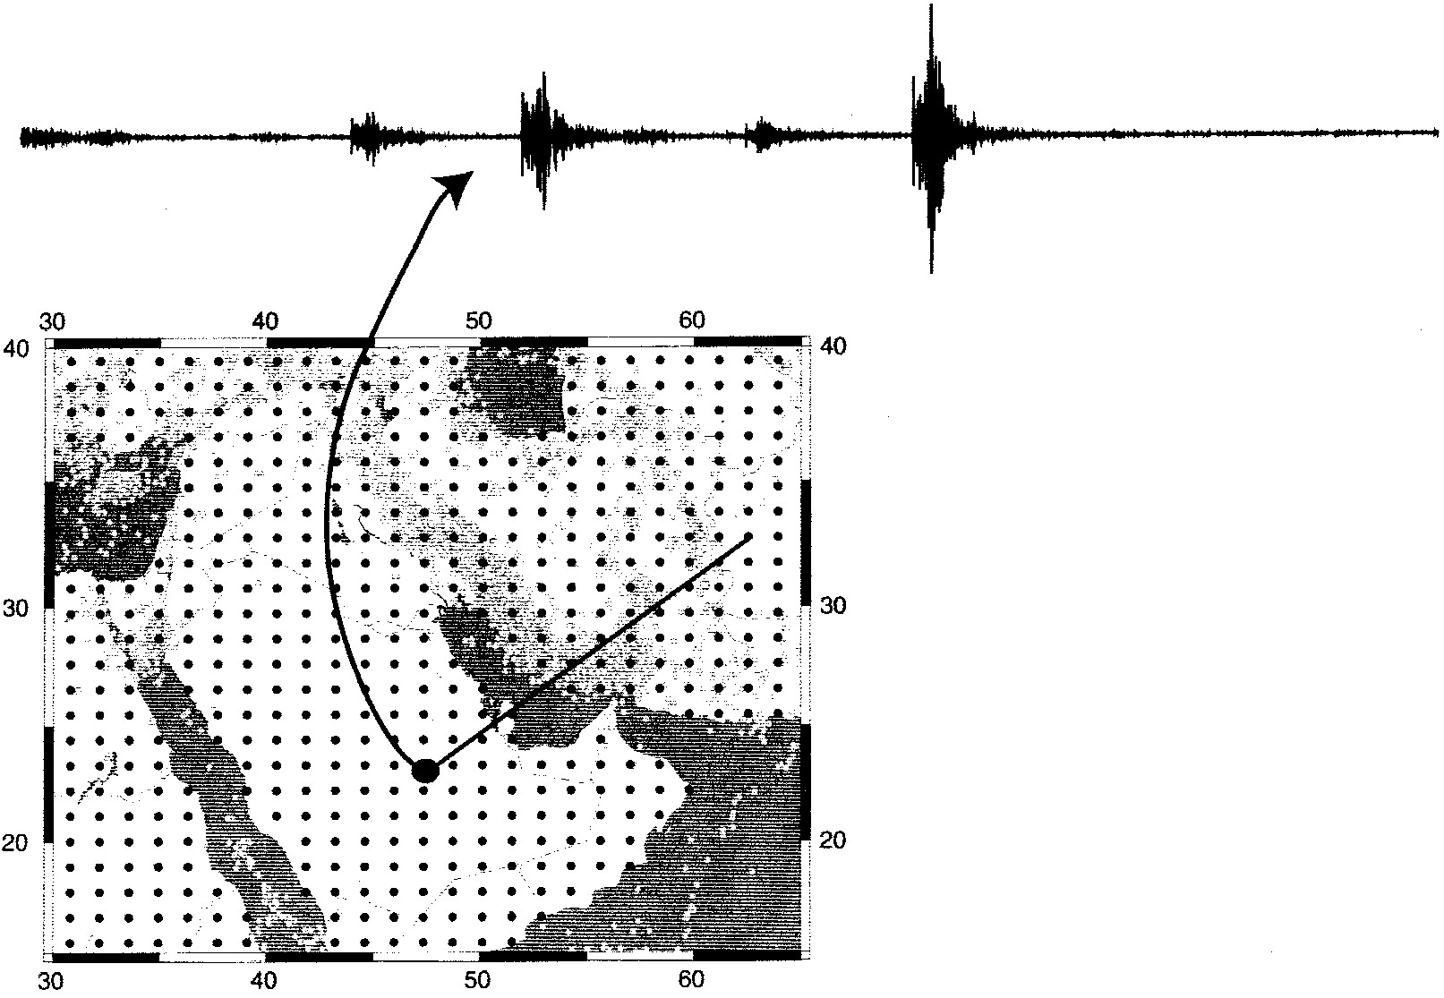
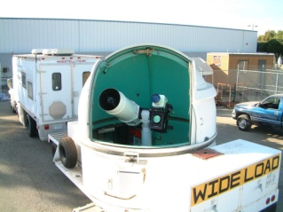
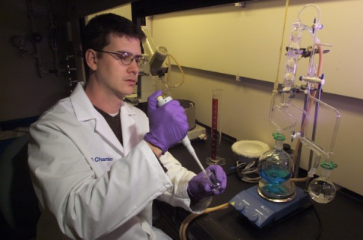
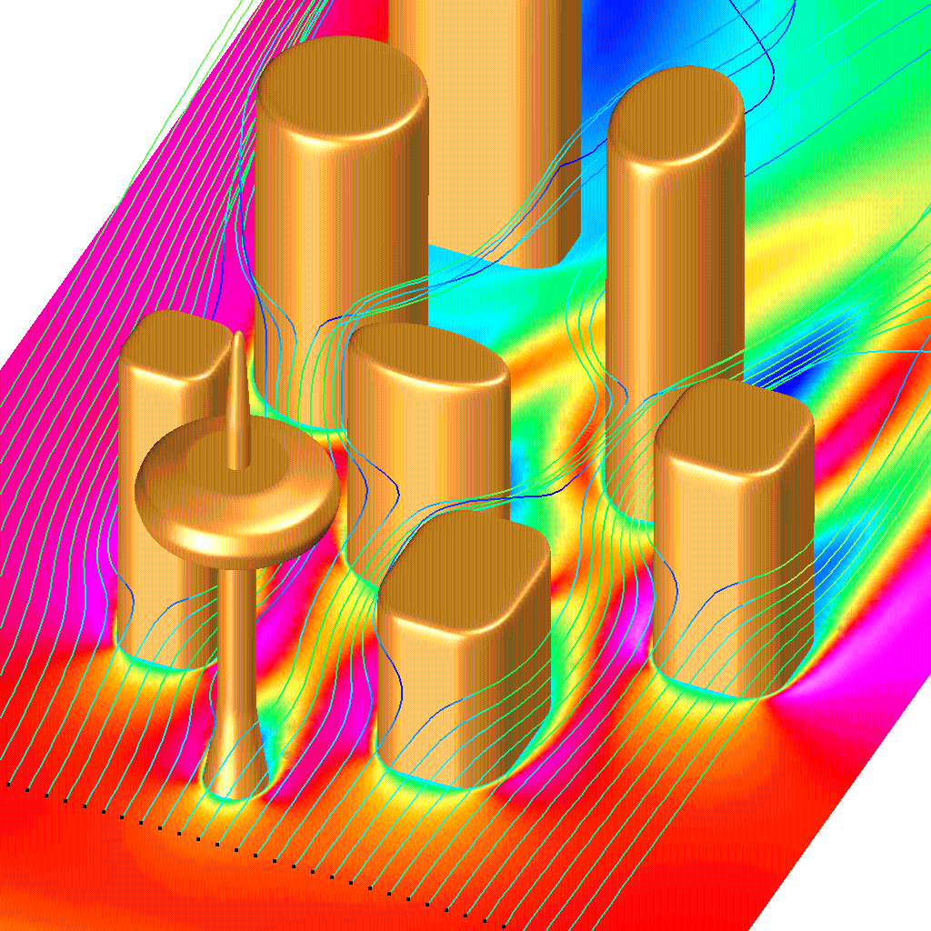
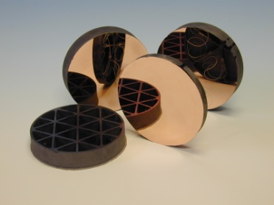

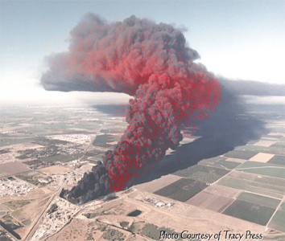
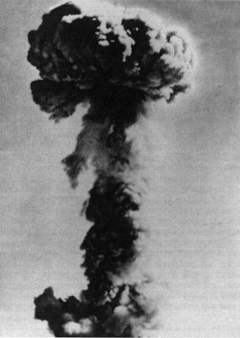
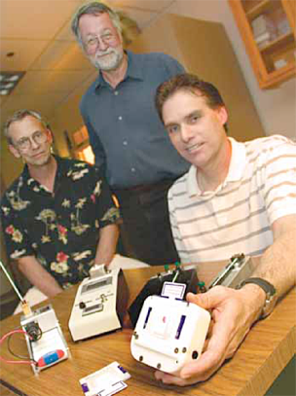
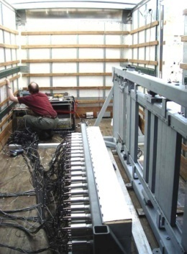
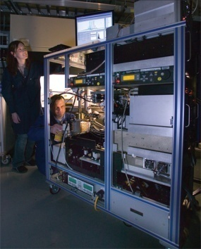

LLNL’s approach is to look for integrated system solutions
Multiple scientific and technical disciplines
Analysis, S&T, and operations
Threats, R&D, prototypes, and products
Notes:
Multiple scientific and technical disciplines (left to right)
Forensic science center
Nanolaminate mirrors
Seismic discrimination of earthquakes/explosions
NARAC urban dispersion modeling
Photomicrograph of B. anthracis
Analysis, S&T, and operations (left to right)
Microbiology laboratory
BKC knowledge management system
Mini-thermal cycler for rapid PCR
SATRN secure high-bandwidth laser comm
LLNL SMEs on UN inspection team in Iraq
Threats, R&D, prototypes, and products (left to right)
Osama Bin Ladin
Atmospheric nuclear blast
Interdicted HEU sample
Large-area Compton imager
NARAC plume prediction overlaid on photo of actual plume (Tracy tire dump fire)
SPAMS (single particle aerosol mass spectrometer)
E.L.I.T.E. explosives test card

Slide 4
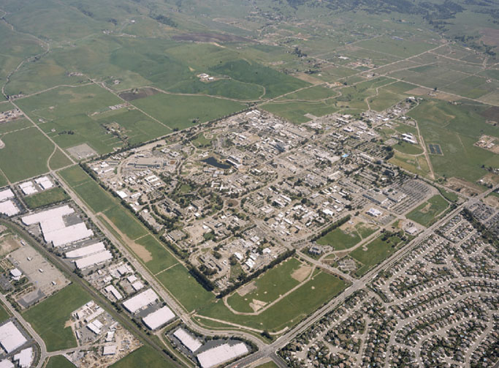
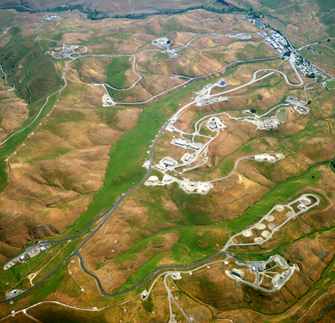
Physical attributes of LLNL sites
Livermore Main Site –1.2 square miles
Total gross square feet: approximately 7.4 million (677 facilities)
Total replacement plant value: approximately $4.3 billion
Nuclear facilities: 7
Approximately 7,500 career employees
Experimental Test Site (11 square miles) near Tracy, California

Slide 5
LLNL Organizational Model
Laboratory Director
George H. Miller
Science & Technology
Global Security
Weapons & Complex Integration
NIF & Photon Science
Operations & Business
Science & Technology
Mission
Operations & Business

Slide 6
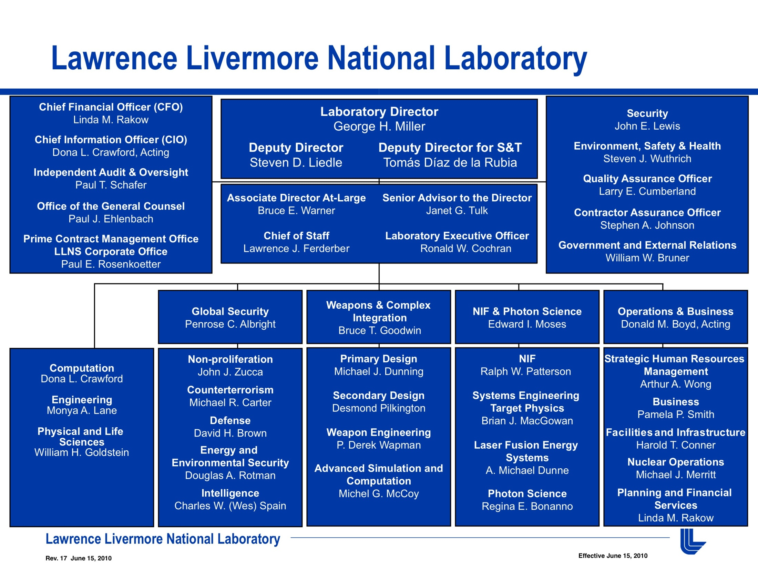

Slide 7
National security activities dominate LLNL’s budget of (approximately) $1.5 Billion
WFO
$217M
Stockpile Stewardship $873M
Homeland Security
$89M
Weapons
Energy
$98M
Advanced Simulations & Computing
Other
$25M
Main Site Restoration
$6M
Facilities
National Ignition Facility
Safeguards & Security
$116M
Nonproliferation
$90M

Slide 8

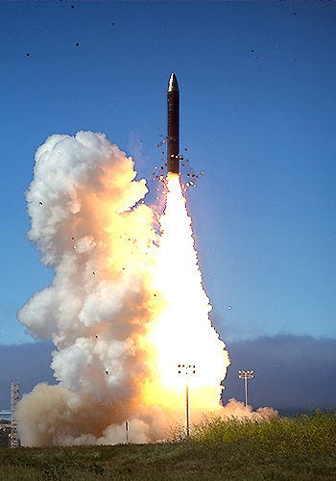
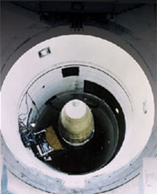
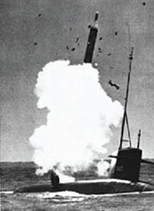
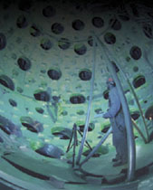
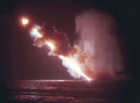
LLNL’s hallmark is innovation: A History of the modern nuclear weapon
1950s
1960s
1970s
1980s
1990s
2000s
Future
Meeting stockpile needs
First 3-D full warhead calculations
Stockpile Stewardship concept developed by Labs/DOE
First battlefield neutron bombs
MX basing studies
Certification of W87 life extension without underground testing
First successful nuclear test with insensitive HE
Small, high yield- to-weight warheads for MIRVed systems
Warhead for Polaris ballistic missile submarine
IHE warheads with modern safety features (e.g., fire- resistant pits)
NIF experiments
Intrinsically one-point safe designs
Petaflop computing
Demonstrated primary and secondary design concepts that form the basis for all current U.S. warheads
Livermore will lead the design for the Reliable Replacement Warhead (RRW) project
ABM warhead development

Slide 9
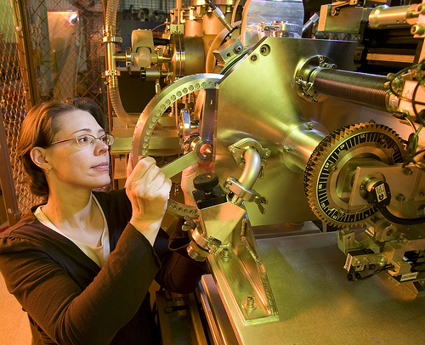
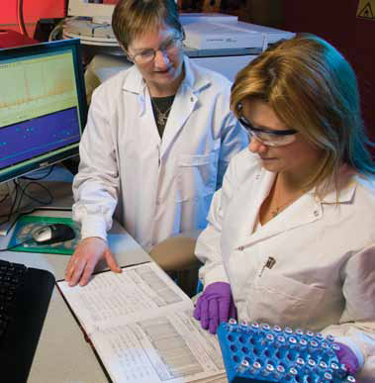
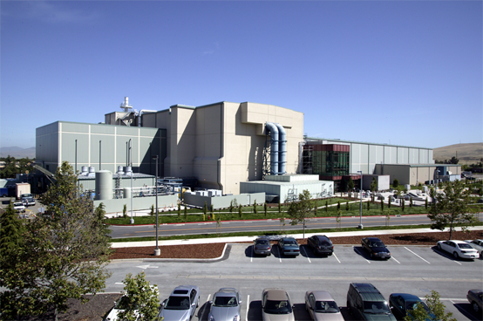
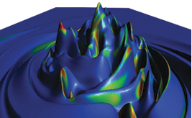
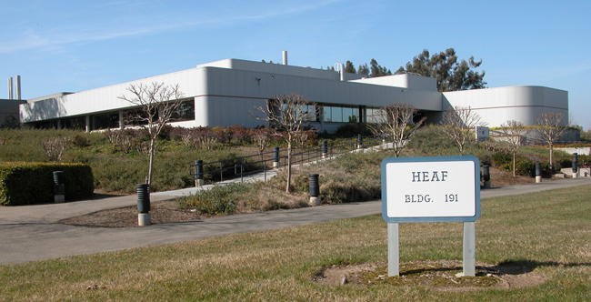
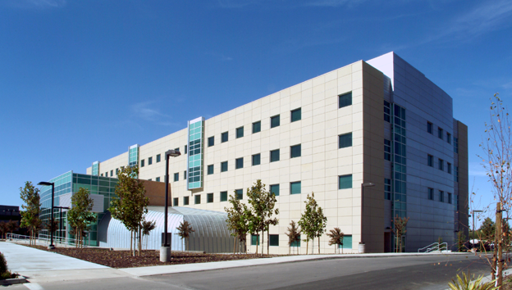
Major LLNL R&D facilities
Center for Accelerator Mass Spectrometry
Forensic Science Center
National Ignition Facility
High Explosives Application Facility
High Performance Computing and Simulation Facility

Slide 10
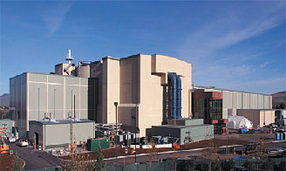
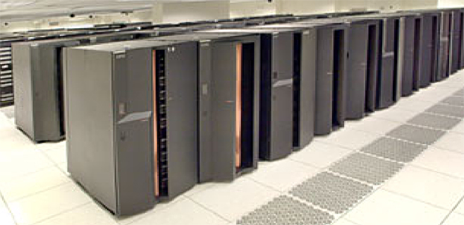
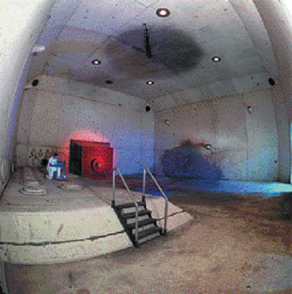
The success of Stockpile Stewardship has required dramatic improvements in scientific tools
National Ignition Facility (NIF)
60x scale up of laser technology
Only place to study the nuclear phase and fusion in the laboratory
Advanced Simulation Capability (ASC) partnership between NNSA-LLNL-IBM has reestablished world leadership
A million-fold increase in capability
Software to run across >100,000 cpus
Advanced radiography (DARHT) — Enhanced image quality
Maintaining confidence in the nuclear deterrent without nuclear testing

Slide 11
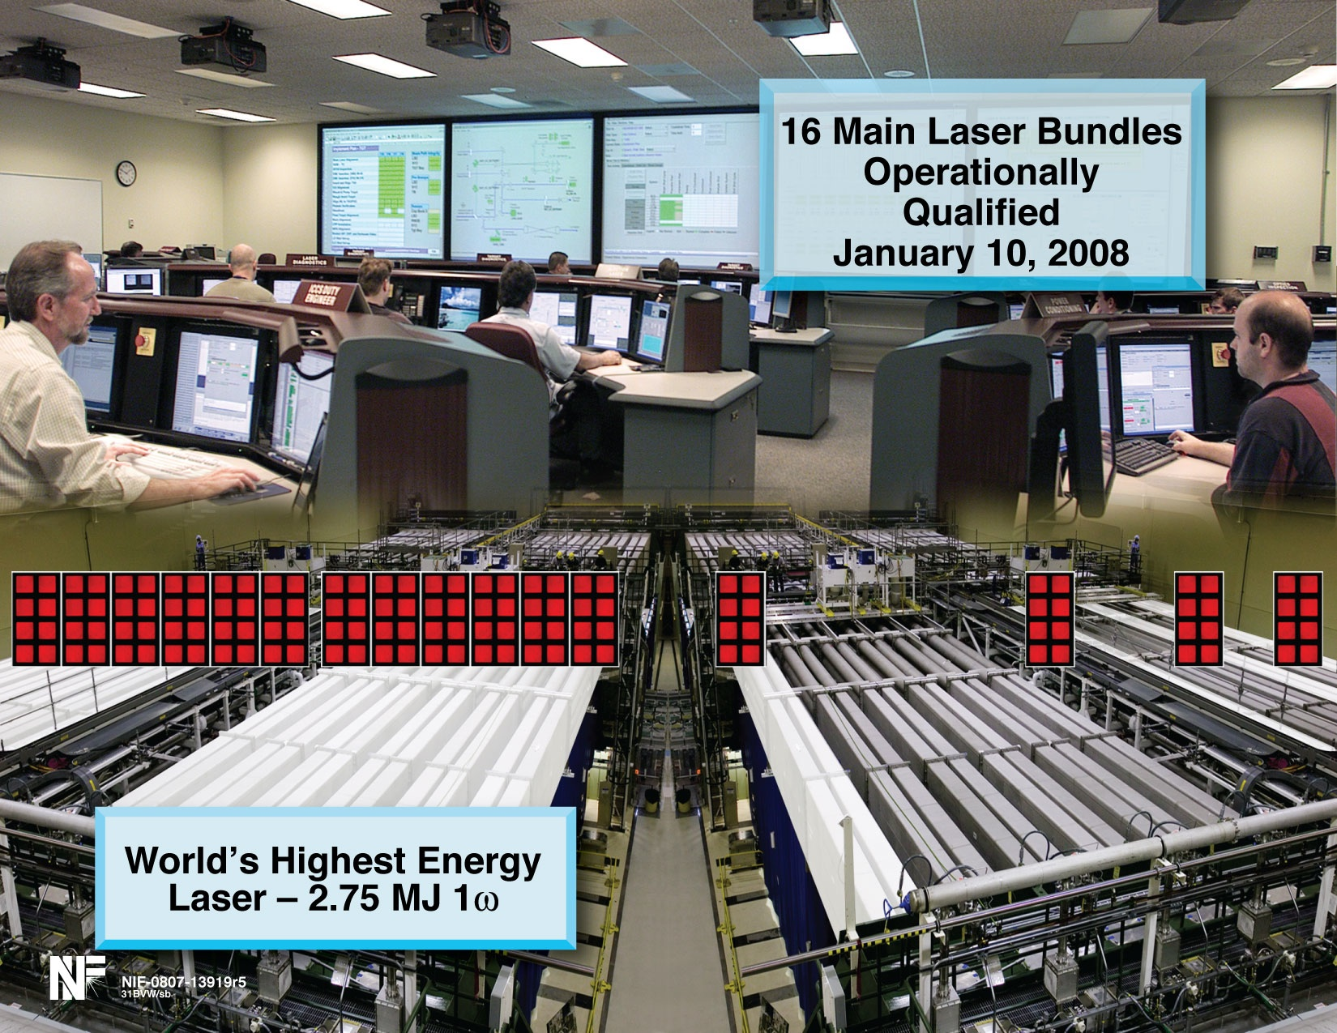


Slide 12
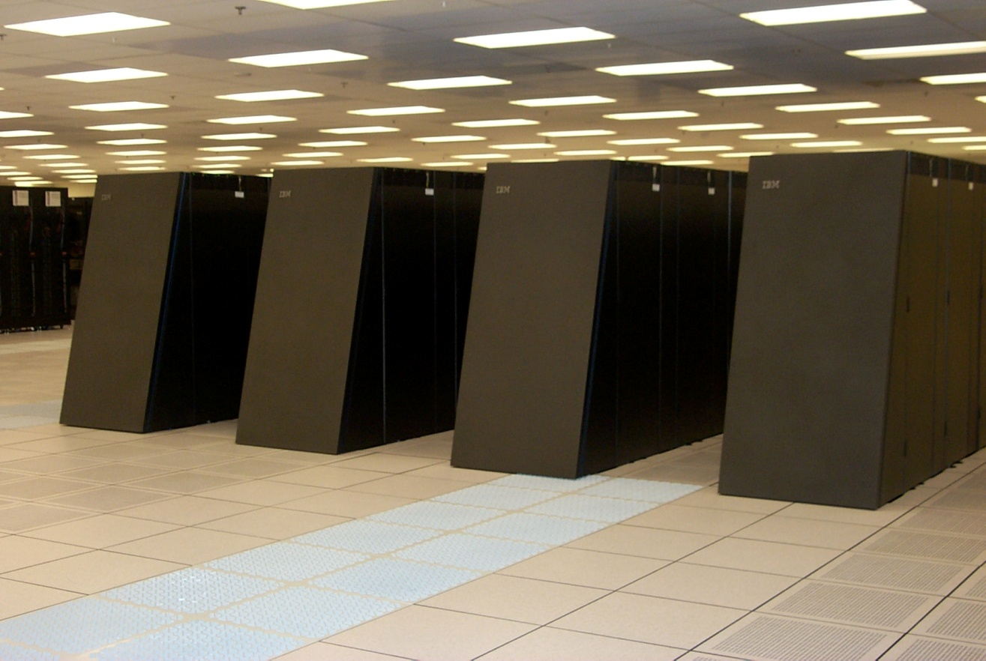
The DOE/NNSA - IBM - LLNL partnership maintains a strong position in advanced computing resources
LLNL’s BlueGene/L remains first on the Top500 List of the world’s fastest computers (Now has a peak speed of 596 teraFLOPS)
We have developed scientific software that effectively uses all 131,000 processors

Slide 13
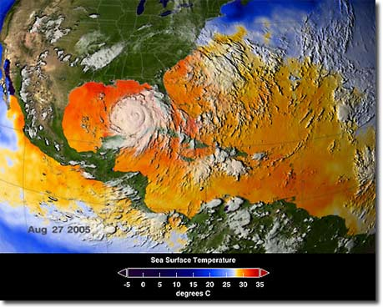
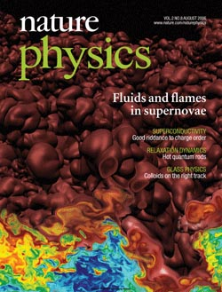
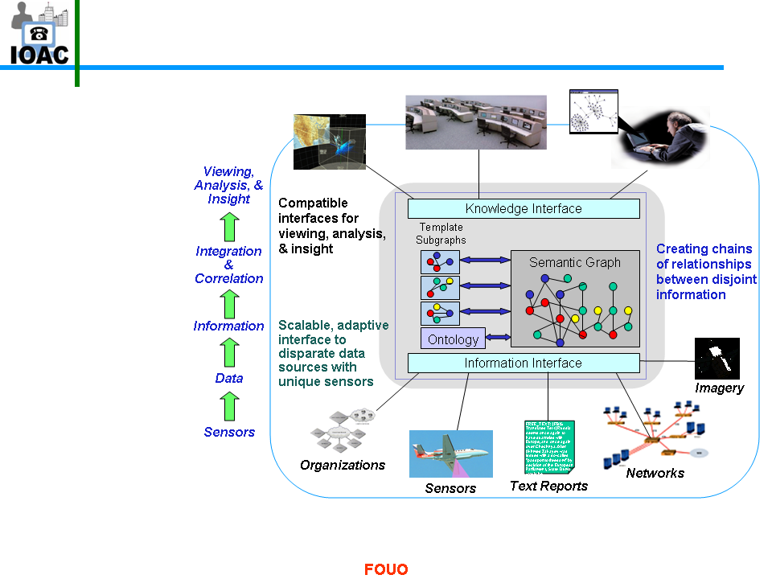
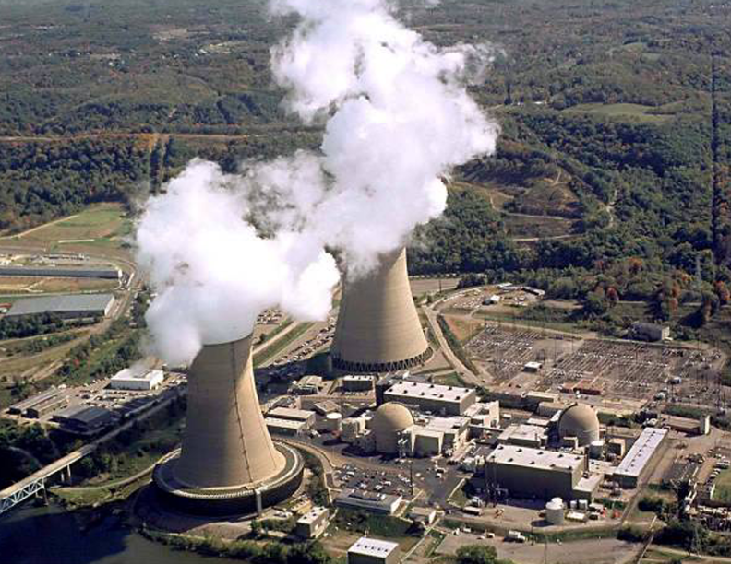
Massively parallel computing is revolutionizing the way science and technology are accomplished
Energy and environment
Stockpile
stewardship
Knowledge discovery
Nuclear Energy

Slide 14
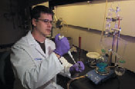
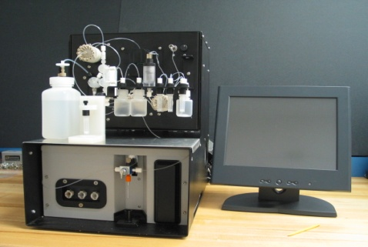
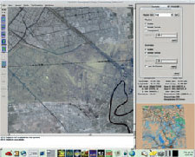
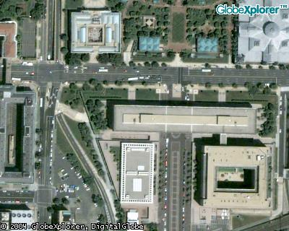
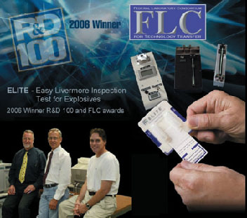
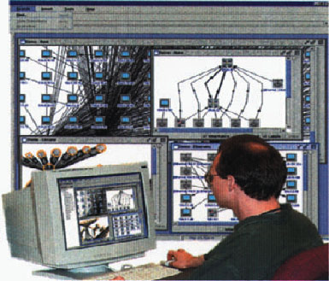
End-to-end technical solutions are the hallmark of our nonproliferation and homeland security activities
Indications and warning
Forensic science and attribution
Biodetection and bio assays
Radiation detection & surveillance
Infrastructure analysis
Conflict simulations
Information science & knowledge discovery
Sensors
Response capability
Image quality ~1 m GSD

Slide 15
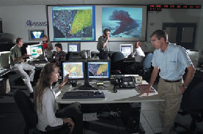
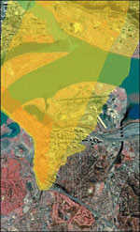
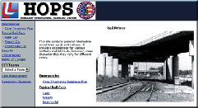
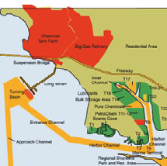





LLNL provides key 24/7 operational capabilities for the nation
National Atmospheric Release Advisory Center (NARAC) / Interagency Modeling and Atmospheric Assessment Center (IMAAC)
Homeland Defense Operational Planning System (HOPS)
Global- to urban-scale dispersion modeling and hazard analysis for emergency response and preparedness
Risk-vulnerability assessments of critical infrastructures and high-value facilities
Forensic Science Center (FSC)
Counterproliferation Analysis and Planning System (CAPS)
Biodefense Knowledge Center (BKC)
Analysis and characterization of samples of proliferation, terrorism, or law-enforcement interest
National clearinghouse for rapid-response and in-depth assessments of actionable biodefense information
Assessments of nation-state WMD programs, critical nodes, and interdiction options

Slide 16






The quality LLNL technology is validated by the R&D 100 Awards competition - Six in 2010
Continuous Phase Plate Optics Manufactured Using Magnetorheological Finishing
Hypre: Fast Solution Algorithms for High-Performance Scientific Computing
Large Area Imager: The Solution to the Search for Illicit Radioactive Materials
MEMS-Based Adaptive Optics Scanning Laser Ophthalmoscope
Noninvasive Pneumothorax Detector
Since 1978, LLNL has received a total of 118 R&D awards

Slide 17
Now Hiring MS and PhD Level New Grads and Students
Mechanical Engineers
Computational Mechanical Analysts
Geotechnical, Materials, Structure and Thermal, Fluids
Mechanical Design
Lasers and Optics
Generalists
Nanotechnology
Electrical Engineers
Computational Electro-Magnetics
Electro-Optics
Signal & Image Processing
Pulse Power
Instrumentation & Controls
High Speed Circuits
Embedded Systems
Other Engineering Disciplines
Software Engineers
Civil Engineers
Decision Science
Statistical Modeling
Systems Engineers

Slide 18






Engagement in wide spectrum of energy and environmental issues
National Atmospheric Release Advisory Center (NARAC)
Earthquake analysis and infrastructure vulnerability
Underground coal gasification and geological carbon sequestration
Climate Model
Diagnostics and Intercomparison

Slide 19








LLNL-developed technologies are strengthening global and homeland security
Defense
Intelligence
Counterterrorism
Nonproliferation
Detecting proliferation or terrorism activities
Notes:
We continue to play an important role in global and homeland security.
Defense:
For example, we’ve developed a persistent surveillance system that can provide real-time video imagery of city-size areas with sufficient resolution to track individual vehicles.
The DoD recently approved a Joint Urgent Operational Need (JUON) requested for a basic 3rd Generation Mk82Our revolutionary conventional weapons: A normal Mk 82 is a 500 lb steel case munition, and is the workhorse for all NATO aircraft; Our version has a carbon fiber case that minimizes collateral damage, coupling precision effects technology with modern precision delivery technology.
Counterterrorism:
Our multiplex assay for foot-and-mouth disease can rapidly detect the virus and differentiate it from other diseases with similar symptoms, a capability that is badly needed to quickly identify and contain a disease outbreak, whether it is naturally occurring or deliberately caused.
We’ve also developed an interactive emergency simulation model that is being used around the country to help train emergency responders, test response procedures, and improve interagency coordination.
Intelligence
Freedom of operation in space is crucial to U.S. interests. In 2008, LLNL initiated a program, working with other National Labs (Los Alamos, Sandia and the Air Force Research Lab), to apply forefront science and technology to improve our country’s capacity for detecting and monitoring threats to U.S. space operations. Utilizing these unique resources, we have begun to develop and demonstrate advanced techniques and technologies for producing actionable space situational awareness, including a comprehensive SSA enterprise simulation framework that was recently used to help analyze the 2009 collision between the defunct Russian satellite, Cosmos 2251, and the operational U.S. communications satellite, Iridium 33.
Nonproliferation:
LLNL plays a leading role in the use of seismic signals to differentiate between nuclear weapons tests and earthquakes.
LLNL forensic analysis is used to determine the source of potential proliferant materials

Slide 20








Broad scientific and technical capabilities
Nuclear Weapons
Science and Engineering
Diagnostics and Sensors
High Performance Computational Engineering
Systems Engineering
Intelligence and Network Analysis
Earth and Atmospheric Science
Materials Engineering
Laser & Electro-optics

Slide 21
LLNL Scientific and Engineering Workforce
Scientists & Engineers by Degree
Technical disciplines
Note: Charts based on scientist & engineer career/flex term population as of 3/31/2010

Slide 22




Engineering is a matrixed organization that provides people, technology, processes, and infrastructure to LLNL programs
Global Security
Weapons &
Complex
Integration
NIF & Photon Science
ENGINEERING
ENGINEERING

Slide 23


LLNL program needs dominate Engineering’s workforce planning
Weapons &
Complex Integration
NIF & Photon Science
Global Security
Weapons engineering: design, development, ground & flight testing
Design & fielding experiments
Code development
Composite Materials
Pulse Power
Precision engineering and manufacturing
Laser subsystems production and commissioning
Concurrent production and optical assembly
Concurrent assembly, commissioning, and experiments
Diagnostics
Instrumentation & Controls
Strong role for Engineering in Department of Homeland Security and other Federal agencies
Rapid prototyping/ demo/deployment
Transfer to industry for manufacture
Detection
Intelligence data analysis
National Ignition Facility
& Photon Science
Global Security

Slide 24

Engineering’s Areas of Expertise Include:
Design, fabrication, test, and measurement capabilities
Engineering software tools and code
Project management
Project and engineering procedures
Engineering standards

Slide 25
Engineering has five Technology Focus Areas
Energy manipulation | High-power electronics and pulsed power: the concentration of energy in space and time to achieve very high energy densities and extreme states of matter
Engineering simulation | Computational mechanics and electromagnetics for modeling of dynamic penetration, energy manipulation, dynamics of materials, laser optics damage, and bio/micro device models
Micro- and nano devices and structures | Radiation and nuclear materials detection, novel techniques and microfluidic protocols for biological security/defense, weapons monitoring, target fabrication (novel materials, metrology, and characterization)
Measurement technologies | Nondestructive evaluation and characterization, metrology for fusion and high-energy-density science, weapons “health” monitoring, weapons detection (radiation, nuclear, explosive, biological)
Knowledge and inference systems | Distilling knowledge, patterns, and inferences from multi-modal systems that create and manage extraordinary or sparse quantities of data

Slide 26

Energy Manipulation Focus Area
High-performance pulse power systems
High-power electronic devices and systems
Explosive-driven pulse power
Helical, coaxial, flat-plate, and other magnetic flux compression generators
Advanced initiation systems for high explosives
Flux transfer and energy delivery under extreme physical conditions
Applications where pulse power and/or power electronics are enabling or critical technologies
High-energy-density physics experiments
High-performance experimental apparatus and systems
Electromagnetic launchers and railguns
Directed energy weapons
All-electric platforms for future combat capabilities
Inductive Adder Kicker Pulser for the International Linear Collider

Slide 27




Engineering Simulation Focus Area
Modeling areas
Dynamic penetration (armor)
Energy manipulation (table-top rail gun)
Dynamics of metals (damage, fracture, spall)
Linear and nonlinear electromagnetics
Glass laser damage
Material deformations and failure
Common themes
Quantification of uncertainty
Optimization and design tools
Multiscale, multiphysics
Electromagnetic simulations of accelerator devices and laser chambers
Mechanical response to extreme environment and validation experiment

Slide 28


Micro- and Nano Devices and Structures Focus Area
Novel fabrication methods and processes with micro/nano-scale precision
Micro/nano-structures for signal transduction (electrical, mechanical, optical, fluidic, chemical, …)
Micro/nano-devices that demonstrate sensing, processing, and actuation
Micro fuel cell
Nanopillar device for high efficiency thermal neutron detection

Slide 29


Measurement Technologies Focus Area
NDE/metrology/diagnostics/remote sensing
Systems integration
Signal and image processing
Research, development, demonstration, test, and evaluation
Sensor systems and platforms
Sources
Detectors
Packaging
Integration
Software
Testing and evaluation
Modeling measurement systems
Tradeoff/sensitivity analysis
As-built modeling
Feature extraction
Data fusion
E4
E5
S5
S4
Mg
C
E3
S1
S3
E1
E2
S2
Validation of explosive simulants
Explosive
Batteries
Wires
Detonator
High-spatial-resolution detector study

Slide 30

Knowledge and Inference Systems Focus Area
Systems that advance our ability to acquire information from large or sparse quantities of information
Massive volumes of data or data-poor environments
Multimodal data
Strong coupling between data and large-scale simulations
Capability for:
Anomaly detection
Inference generation
Real-time alerts
Uncertainty quantification
Information valuation
Applications to:
Large-scale science experiments
Environmental analyses
Laboratory missions
5 million+ edges
The Opte Project – internet network

Slide 31



Engineering has three Centers of Excellence
Center for Micro- and Nanotechnology
We continue to develop flexible thin film electrode array technology that is being used in implantable epiretinal prostheses. Our engineers and scientists are working as part of a larger collaborative effort by several laboratories and institutions, funded by the Department of Energy (DOE) Office of Science, to help restore useful vision to those diagnosed with retinitis pigmentosa and age-related macular degeneration.
Center for Nondestructive Characterization
The Center plays a strategic and vital role in the R&D of NDC technologies—such as acoustic, infrared, microwave, ultrasonic, visible, and x-ray imaging—to enable Engineering to incorporate these technologies into Laboratory and DOE programs. The Center invests in multidisciplinary integration of NDC methods, e.g., using physics modeling and signal and image processing.
A microelectrode array for retinal prosthesis.
0.5 mm
Ablator wall thickness calculated from CT
CT image showing foreign material (in dashed circle) embedded in aerogel
Double-shell targets meet design specifications

Slide 32

Engineering has three Centers of Excellence (continued)
Center for Precision Engineering
Precision engineering is a multidisciplinary systems approach to achieve an order of magnitude greater accuracy than currently achievable. Research projects include digital tachometer for precision machine tools, high-stiffness hybrid passive/active magnetic bearing for precision engineering applications, hydraulic power unit for hydrostatic bearings, interferometer filter system for precision machine tools, nano-mechanical characterization tools for in-situ deformation and morphology of materials, and precision x-ray optics development.
BLAST galactic survey telescope mirror

Slide 33
LLNL Workforce Demographic Overview

Slide 34
PAD Diversity Metrics – Utilization%
Total Workforce
Professionals Only
% of LLNL Workforce
% of LLNL Workforce
Comparison of Representation to Availability (equal bars = 100% utilization)
Data as of 3-31-10

Slide 35
Contact Information
Tommy Smith
Director, Office of Strategic Diversity Programs
smith80@llnl.gov
925 422-6634
Bethany McCormick
Engineering Recruimment
mccormick11@llnl.gov
925 423-0174

